Slide 1
BD LAB INTERNAL
Yogeshwari A
1NT18IS188

Slide 2
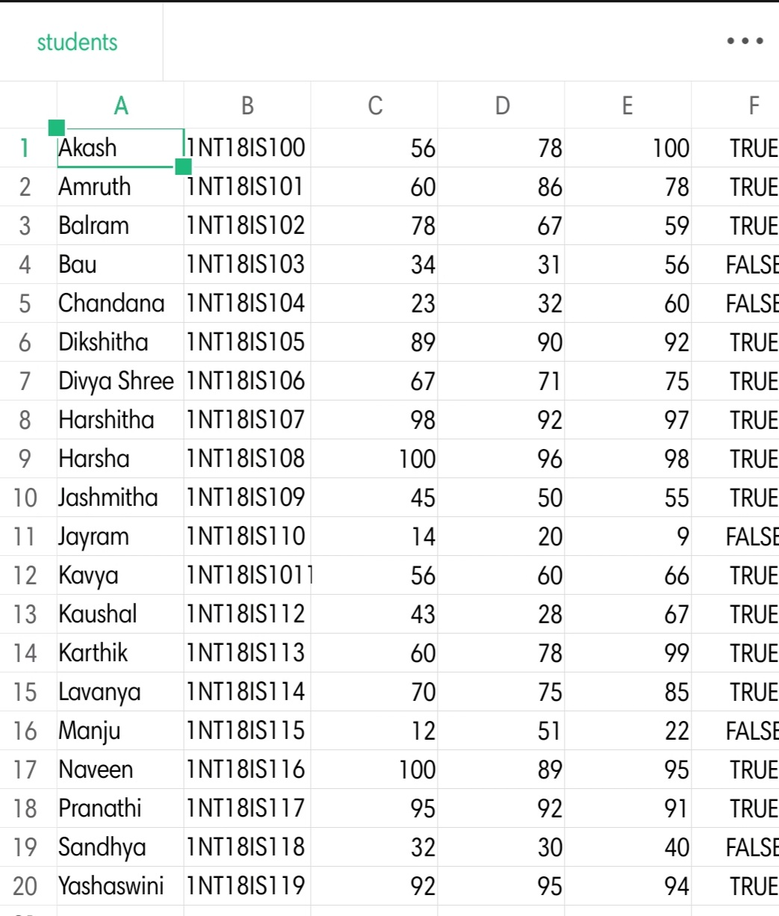
Prepare a dataset of 20 records in the following format
Name | USN | Subject1 | Subject2 | Subject3 | Pass/Fail
String | Int | Int | Int | Int | Bool

Slide 3
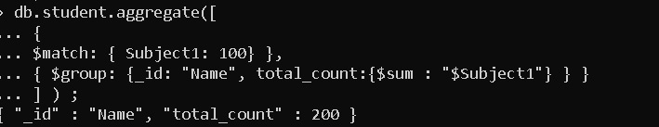
1. Demonstrate the usage of $match, $group, aggregate pipelines.
2. Count the number of students who had passed in at least 2 subjects.

Slide 4
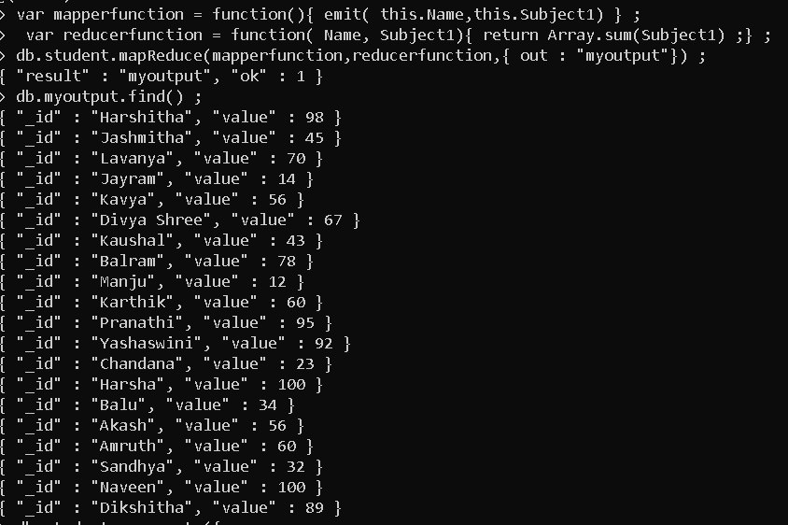
3. Demonstrate the Map-Reduce aggregate function on this dataset.

Slide 5
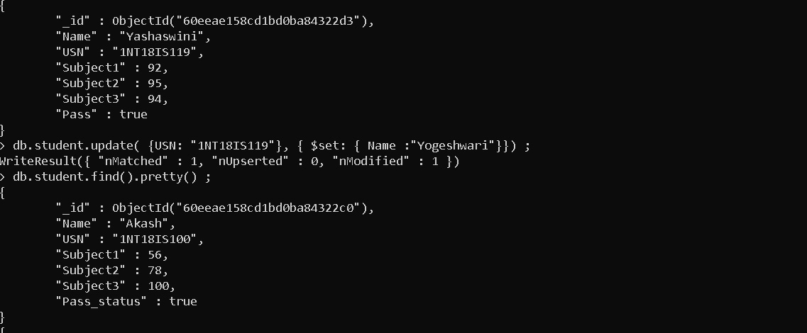
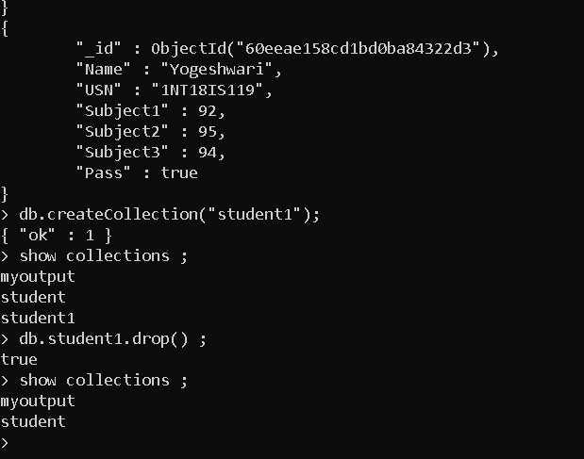
4. Demonstrate the Alter and Drop commands on this dataset.

Slide 6
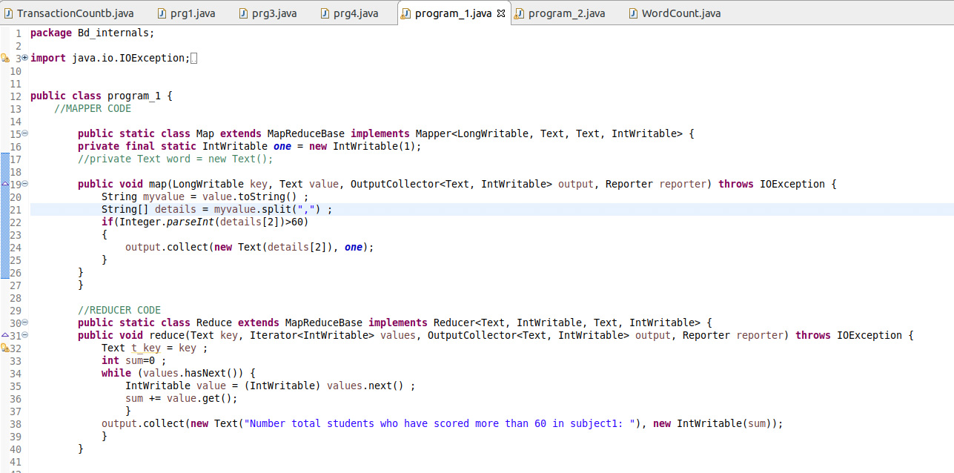
Hadoop-MapReduce
Use the Hadoop MapReduce programming framework to compute with a program which will take the data from this .csv file and compute the following.
1.Total number of students who have scored more than 60 in subject 1

Slide 7
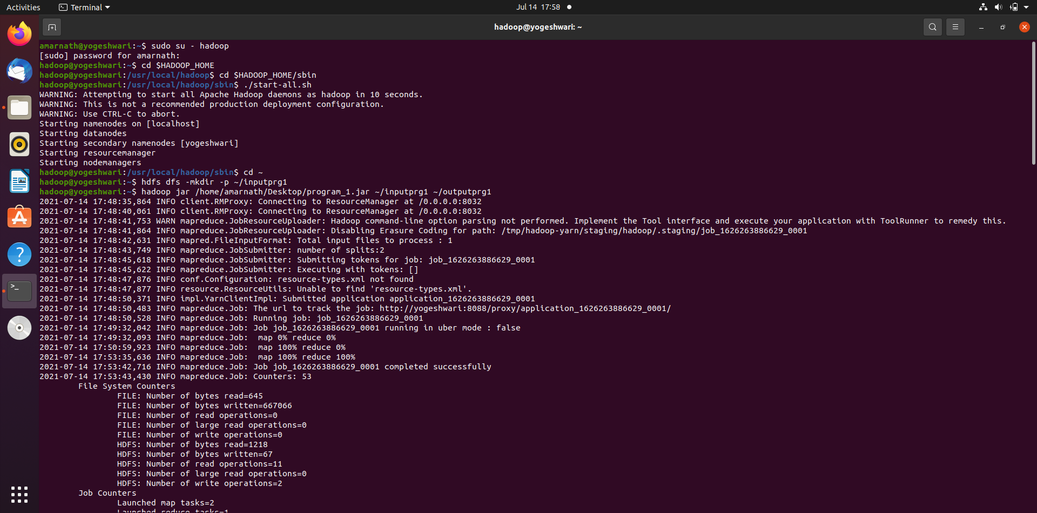
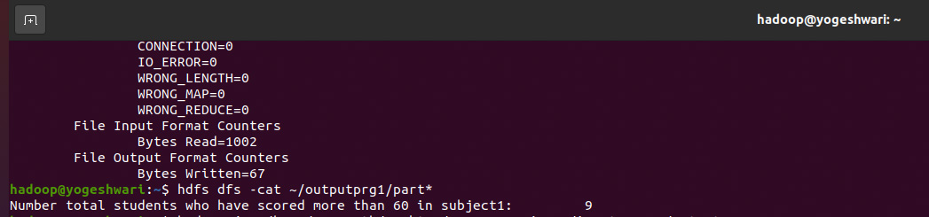

Slide 8
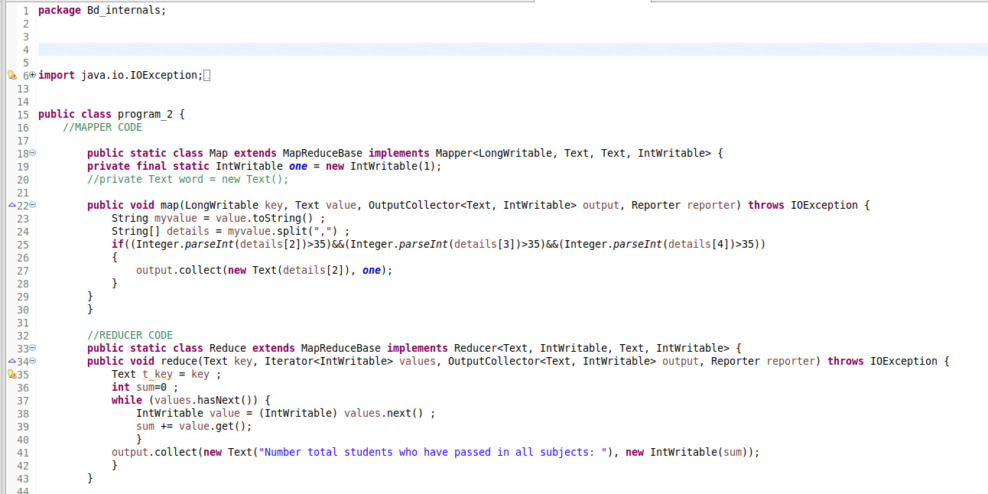
2. Total number of students who have passed in all subjects

Slide 9
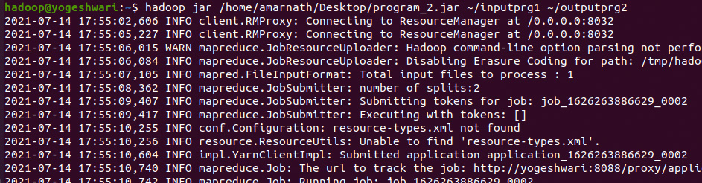


Slide 10
THANK YOU

